Slide 1
Social and Behavioral Sciences in Public Health - Doctor of Philosophy (Ph.D.) in Public Health Sciences
Here is where your presentation begins

Slide 2
Contents of this template
You can delete this slide when you’re done editing the presentation
Fonts | To view this template correctly in PowerPoint, download and install the fonts we used
Used and alternative resources | An assortment of graphic resources that are suitable for use in this presentation
Thanks slide | You must keep it so that proper credits for our design are given
Colors | All the colors used in this presentation
Icons and infographic resources | These can be used in the template, and their size and color can be edited
Editable presentation theme | You can edit the master slides easily. For more info, click here
For more info:
Slidesgo | Blog | FAQs
You can visit our sister projects:
Freepik | Flaticon | Storyset | Wepik | Videvo

Slide 3
Table of contents
01
02
03
04
Overview
Dive into the university-level social studies curriculum
Academic landscape
Navigate the complexities of advanced social studies
Core foundations
Establish a robust foundation for deeper academic exploration
Significance and application
Explore the importance and practical applications of social studies

Slide 4
Introduction
Welcome to the elevated realm of university-level social studies, where the exploration of human societies, histories, and cultures reaches new heights.
In this academic journey, students delve into advanced concepts, critical analysis, and interdisciplinary perspectives to cultivate a profound understanding of the intricate tapestry that weaves societies together
Embarking on this scholarly voyage, students will navigate the rich landscapes of political systems, economic structures, historical narratives, and cultural dynamics.
The program fosters critical thinking, research proficiency, and a nuanced comprehension of the complexities that shape the world. Together, we embark on a quest for intellectual enrichment and a deeper appreciation of the social fabric that binds all

Slide 5
01
Overview
An in-depth exploration of the social studies program at the university level

Slide 6

Social studies overview
In social studies at university, we will explore:
Historical narratives
Political systems
Culture perspectives
Embarking on this academic expedition, students synthesize critical insights into the human story, laying the groundwork for informed perspectives and engaged citizenship in an ever-evolving global landscape. This is a small overview!

Slide 7
Academic landscape
Diverse diversity
Research mastery
Global perspectives
Explore sociology and more for a comprehensive societal understanding
Develop critical thinking through historical research, fostering analytical skills
Embrace diverse viewpoints for an interconnected worldview
Historical narratives
Civic empowerment
Cross-culture insight
Immerse in captivating histories, for shaping our present and future
Encourage active civic participation, empowering students for positive changes
Foster cross-cultural understanding, equipping students with tools

Slide 8
Our amazing and diverse world is shaped by social studies

Slide 9
123,000
Using numbers in these presentations provides precision and clarity, allowing to quantify and support key information

Slide 10
The best places to study social studies
Location 1
Explore learning and research at this university
Location 2
Foster innovation and diversity at this university
Location 3
Discover a dynamic center for learning at this university

Slide 11
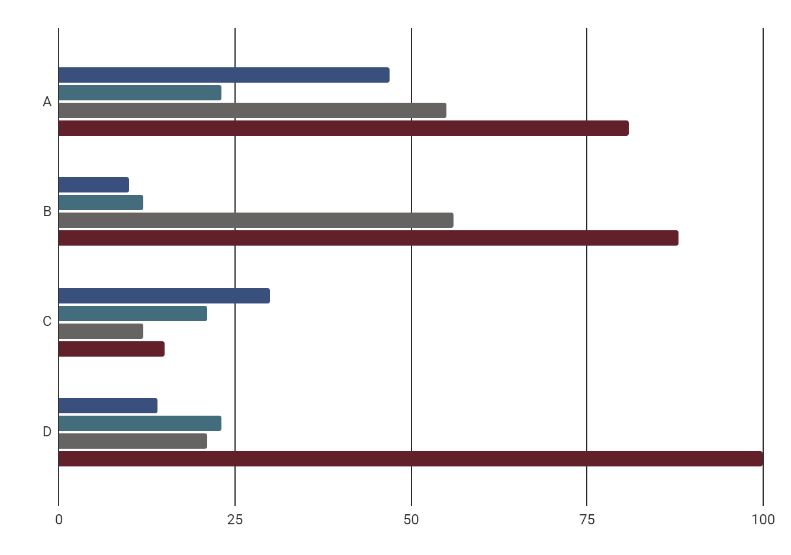
Academic performance analysis
Scholarly achievement
Educational excellence
Intellectual growth
Academic success
Follow the link in the graph to modify its data and then paste the new one here. For more info, click here

Slide 12
Approach to social studies
Curiosity spark
Critical analysis
Resource exploration
Research skills
Context understanding
Effective communication
Diverse perspectives
Continuous learning

Slide 13
Key elements of social studies
History
Geography
Economics
Sociology
Social studies
Political science
Civics
Anthropology
Archaeology

Slide 14
Core foundations
Understanding the roots
Critical thinking and analysis
Social studies serves as the backbone of education, providing students with a comprehensive understanding of the world's key disciplines. It encompasses history, geography, economics, political science, sociology, civics, anthropology, and archaeology
The core of social studies lies in fostering critical thinking and analytical skills. Students delve into historical events, explore diverse cultures, and analyze societal structures. This foundational knowledge equips them with the tools needed to interpret complex issues

Slide 15
Rubric
Criteria | Excellent (4) | Good (3) | Basic (2) | Limited (1)
Historical thinking | Demonstrates a deep understanding of historical themes | Shows a solid understanding of historical themes | Demonstrates a basic understanding of historical themes | Shows a limited understanding of historical themes
Civic thinking | Demonstrates a deep understanding of civic concepts | Shows a solid understanding of civic concepts | Demonstrates a basic understanding of civic concepts | Shows a limited understanding of civic concepts
Research | Demonstrates a deep understanding of the topic and incorporates a wide range of sources | Shows a solid understanding of the topic and uses several relevant sources | Demonstrates a basic understanding of the topic and uses a few relevant sources | Shows a limited understanding of the topic and uses few or no relevant sources
Writing | Demonstrates excellent writing skills, including proper grammar and spelling | Demonstrates good writing skills, with only minor errors in grammar and spelling | Demonstrates basic writing skills, with some errors in grammar, and spelling | Demonstrates poor writing skills, with frequent errors in grammar and spelling

Slide 16
Assignment brief
Course | Social studies
Unit | Understanding social issues
Project title | The social issues challenge
Tutor | Dr. Tutor
Start date | MM/DD/YYYY
Deadline | MM/DD/YYYY
Abstract of the unit
This unit is designed to help students understand the concept of social issues and their impact on society. They will explore the history of social issues, analyze current social issues, and develop strategies
Assignment brief
The students will work in groups to identify a social issue and develop a plan for addressing it. The plan should include a description of the issue, an analysis of the root causes, and recommendations for addressing it

Slide 17
Case study
This case study exercise aims to help students understand the impact of social media on society. Students will analyze the effects of social media on different aspects of society, including politics, culture, and communication
Instructions
Introduction: Begin by introducing the topic of social media and its impact. Provide students with a overview of the different ways in which social media has affected society
Case study analysis: Divide students into groups and provide each group with a case study that examines the impact of social media on a specific aspect of society
Group discussion: After analyzing the case studies, have each group present their findings to the class. Encourage students to discuss the similarities and differences
Conclusion: Ask students to reflect on what they have learned and to consider how they can apply this knowledge to their own lives

Slide 18
Conclusions
Fostering global minds
Empowering critical thinkers
Responsible citizens
In conclusion, social studies serves as the bridge to a more globally minded and culturally aware generation, promoting interconnectedness and understanding
The discipline of social studies empowers students to become adept critical thinkers, equipped with the skills needed for analyzing and understanding complex societal issues
To conclude, social studies lays the foundation for responsible citizenship, cultivating individuals who are not only knowledgeable about the world's past but also engaged and proactive in shaping its future

Slide 19
Thanks!
Do you have any questions?
youremail@freepik.com
+34 654 321 432
yourwebsite.com
Please keep this slide for attribution

